Slide 1
Hourlify
Workforce management in motion

Slide 2
ABSTRACT
Effective Resource Management is a valuable key for any organization to function according to its maximum potential. Since manpower is a constant aspect in all commercial entities, profits greatly depend on the proper utilization of payable manpower hours. At present, there are plenty of existing apps in the market, all claiming that their tool facilitates effective resource management. However, though resource management may be thriving, the workforce data monitoring aspect somehow lags behind.
Workforce Data Monitoring is a phase of the Resource Management process that plays a very important part of analyzing the real conditions of the staffing assets, but is often neglected and paid less attention to in development. Though plenty of accurate tools and calculations for resource management are already incorporated to Resource Management apps to perform this function, data correctness and fidelity would almost be useless if it is in a form that is not 'readable' to the people needing the data. Hence, Project Hourlify is created to respond to the ongoing need for an effective, accurate, yet understandable way of managing workforce information.

Slide 3
BACKGROUND

Slide 4
BACKGROUND
Project Hourlify is inspired on the recent discussions and systems encountered by its creators that pertains to harnessing workforce availability and management information. Based on their observations, most of the data analytics systems nowadays offer decent interface for data input, but presents data in complicated tables and graphs, requiring advanced understanding of the analytics concept to be properly interpreted by the reader.
Given this premise, the creators have conceptualized Project Hourlify as a workforce data management tool that can present its data in organized tables, clean texts, and crisp graphs and charts. That the same dynamic data can be presented in another way wherein the viewer of the data can already have a good understanding of the workforce status at a glance.
In order for Project Hourlify to achieve all this, it depends on Tableau (r), an up and coming data analytics tool in the market that managed to fuse data correctness and efficiency together in one package. Also, since Tableau (r) is designed to work with major data formats, Project Hourlify is very much capable of being integrated into other reports generating systems and deliver the results live and correct. And to make sure that the data being processed in the system is safe and stable, Project Hourlify creators also boosted its security features.

Slide 5
STATEMENT OF THE PROBLEM

Slide 6
STATEMENT OF THE PROBLEM
This project is centered on providing data-to-report solutions in presenting workforce management data that is correct but can be more easily understood by users through visual graphics. Specifically, this project also seeks to address the following issues that currently exists in the field of Resource Management:
1.Improve ease of understanding data through visual presentation of information.
2.Highly accurate data based on the 'source' contents.
3.Capable of integration with most/major report data formats.
4.Version-capable system to cater to multiple versioning needs
5.Secure safekeeping of data and system

Slide 7
PROJECT SIGNIFICANCE

Slide 8
SIGNIFICANCE OF THE PROJECT
The team who undertook this project came up with Hourlify in hope that the following sectors of the industry will benefit from the system:
To the Resource Managers. May this enable them to keep pace with the needs of a fast-changing landscape in manpower resourcing. May this serve as in aid to them in the continous pursuit if improving and advancing Resource Management through the use of tools and systems in viewing and planning resources for project deployments.
To the Human Resource departments. May this project help renew their grasp of the importance of workforce management when applied to every facet of project. May this project help strengthen their support to uphold effective processes and method of Resource Management at parallel with the other respected management procedures in the company.

Slide 9
SIGNIFICANCE OF THE PROJECT
To the Project/Program Managers. May this project serve as an eye-opener for them to take into consideration the complex aspects required in when managing resources per project. Through this project, may they also be enlightened on the actual status and distribution of workforce per season per project.
To Kaisa Business Development Managers. May this project become a catalyst of evolution for the business ideas that we can be offering to our prospective clients. May this project become a valuable additional feature not only to our existing product line, but to our other up and coming products independently developed by Kaisa.

Slide 10
SCOPE AND LIMITATIONS

Slide 11
SCOPE
Timesheet database from Day 1.
Hourlify can lookup historical timesheet database since a company started recording timesheet entries.
Daily, monthly, quarterly, yearly, and historical graphs and reports can be viewed in Hourlify.
Display of Forecasted data based on the data source.
DIsplay of Actual data based on marked actual work.
Display of reports via text, graphs, and charts, etc.

Slide 12
LIMITATIONS
Hourlify is limited only by available database storage and possibly bandwidth if remote report generation is required.
The speed of executing graphs and reports are greatly enhanced by intelligent caching in the database, as well as report optimization in Tableau.
Number crunching and other forms of computation are dependent on the underlying infrastructure of the data source.

Slide 13
ADVANTAGES
Detailed view of hours rendered by employees
Historical, timeline, and forecasted views of hours rendered
Can pinpoint strong and weak points of resource allocation
Can leverage advantage of proper resource allocation
Can identify and take action on misallocation of resources

Slide 14
TECHNICAL FRAMEWORK

Slide 15

System Architecture
Interactive Reports, Dashboards, and Storyboards
Timesheet / HR Database
Tableau

Slide 16
Use Cases
Employee
Fill Up Timesheet
Perform Tasks
Project Manager
Manage Resources
Personnel Manager
Identify Resource Requirements
Allocate Resources
Monitor Resource Allocation
HR
Hire Resources
Retain Resources
Train Resources
Top Management
Formulate Strategy

Slide 17
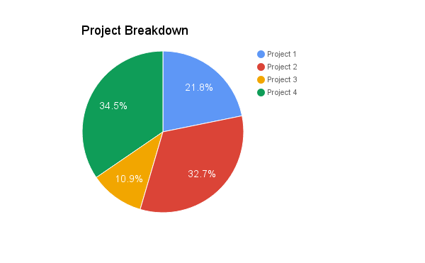
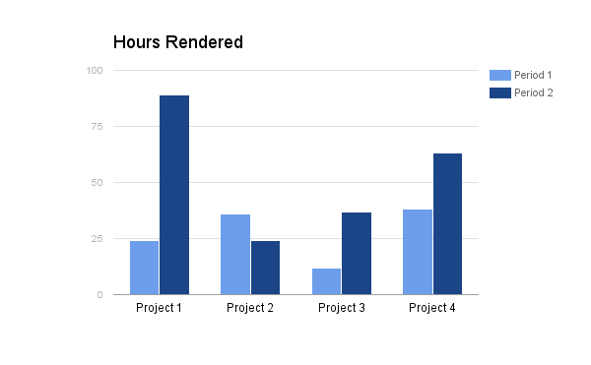
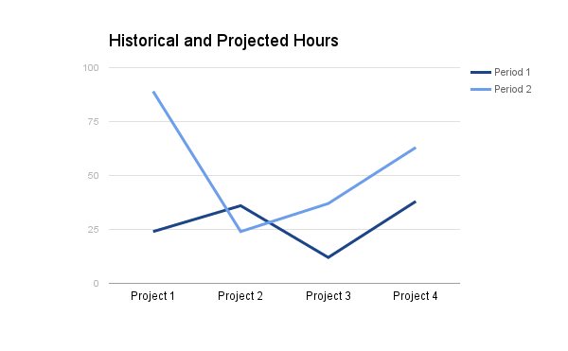
Hourlify Storyboard

Slide 18
Project Breakdown

Slide 19
Hours Rendered

Slide 20
Historical and Projected Hours

